Slide 1

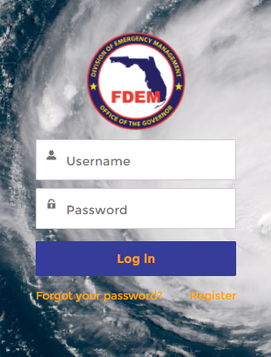
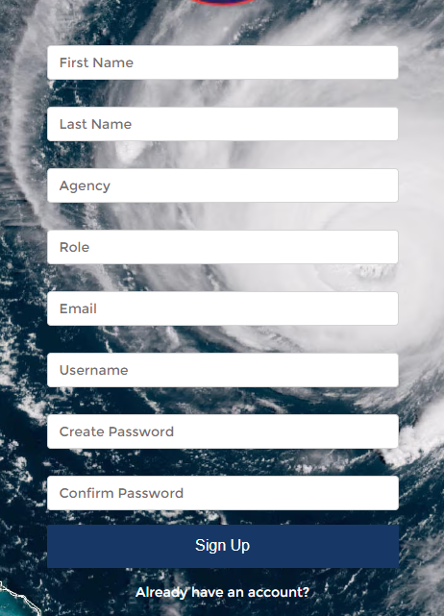
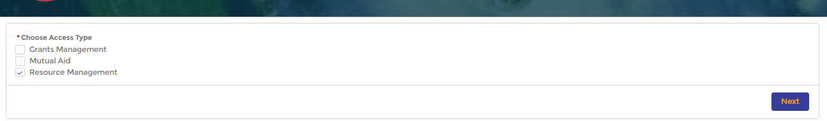
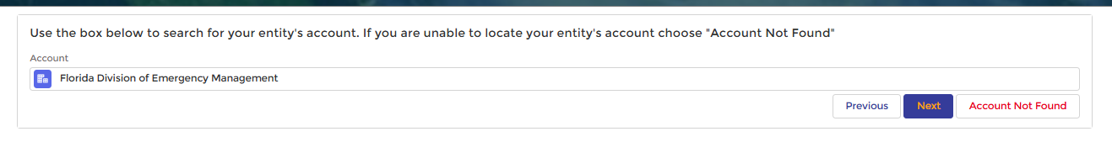
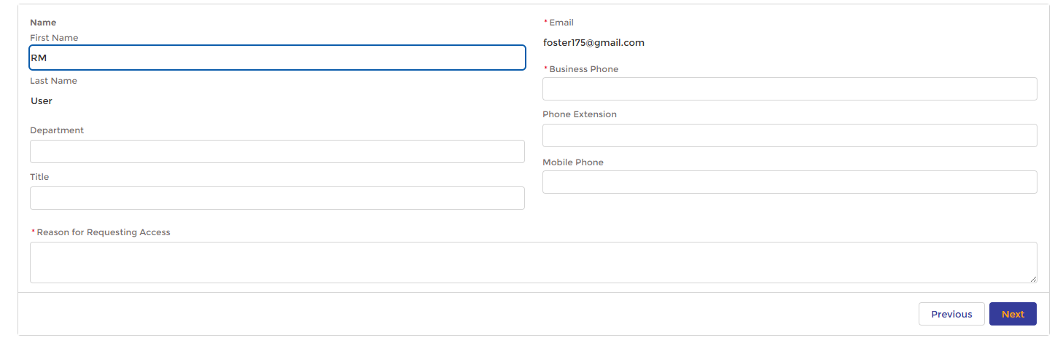
Resource Management
Registration
The Resource Management system provides real-time snapshots of resources and equipment during activations. This system ensures the standardization of mobilization, demobilization, and damage reporting processes across different agencies and incidents and integrates with the Mutual Aid system for efficient claims processing.
Registering for a Resource Management Account
How to:
From https://www.fdemportal.com/grants, select Register
Enter in your user details
Select Sign Up
Select Resource Management in Choose Access Type
Select Next
Search for and select your entity’s account
If you cannot find an account for your entity, select Account Not Found
Select Next
Type your Agency’s Business Phone number
Enter the Reason for Requesting Access
Select Next
The user will receive an email confirming the request has been received.
2
1
3
4
5
6
7
8
tester
9
10
https://www.fdemportal.com/grants/

Slide 2
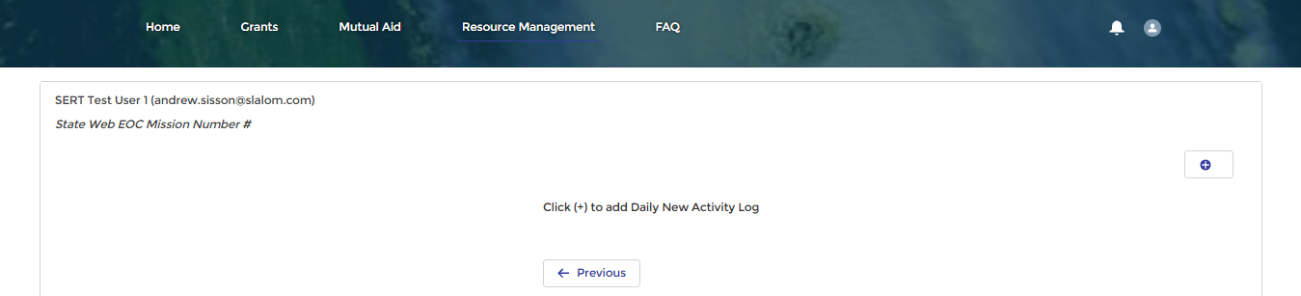
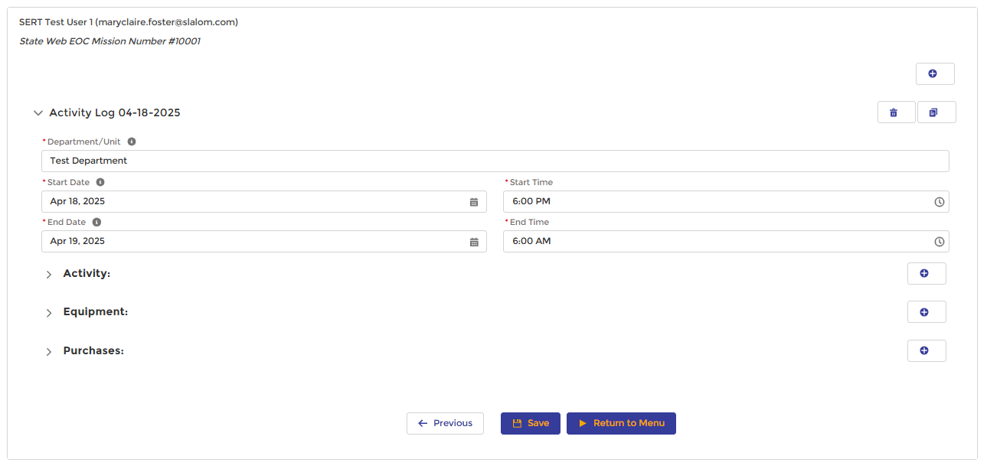
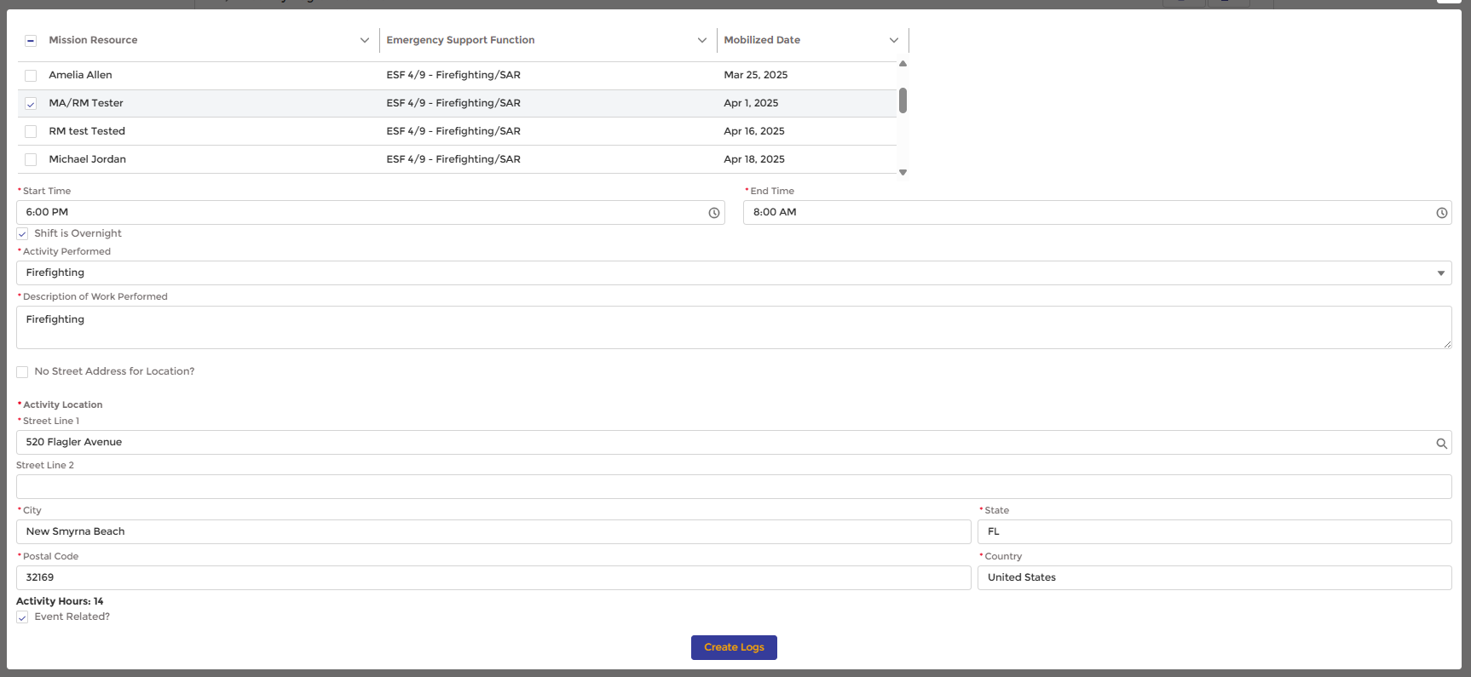
Resource Management
Recording Mission Activities
Once mobilized, users can record daily activities for a Mission in the Daily Time/ Activity Logs section of the Resource Management portal
Creating Daily Activity Logs
How to:
Click the + button to create a new daily activity log
The log is created and will automatically be labeled with the current date
Expand the log to add the following details:
Department/Unit
Start Time
End Date
End Time
Select the + button to create an activity log line
Select Mission Resources participating in the activity
Enter the Start Time and End Time for the activity
If the shift is overnight, select Shift is Overnight*
Select the Activity Performed from the list
Enter a short Description of Work Performed
Enter the Activity Location information
If there is no street address, select the checkbox and fill out the Activity Location details
Select Create Logs once complete
1
2
3
4
6
5
7
8
Overnight Shifts –
If a shift spans over two days, the user will select “Shift is Overnight” to trigger the system to create two entries.
IMPORTANT: Only personnel who have been mobilized can be added to a daily activity log. If an agency has new team members who are not yet registered within DEMES, those members must register for the Resource Management Portal to ensure they are included in the list of agency resources.

Slide 3
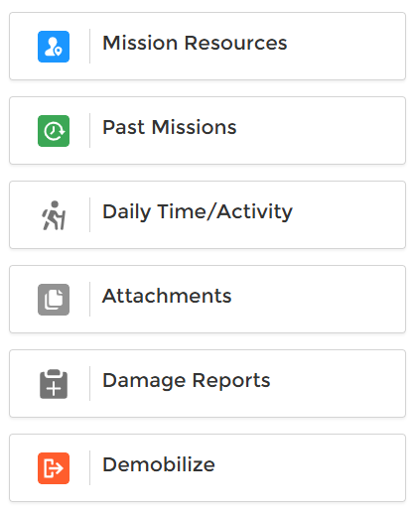



Resource Management | May 2025 Enhancements
Key Updates
Updated Resource Management Main Menu
Mission Resources – View and manage mobilized Personnel and Equipment
Past Missions – View and manage activity logs for Historic and Ongoing Missions
Daily Time/ Activity – View and manage activity logs
Attachments – View and manage receipts submitted for claims
Damage Reports – Create and edit damage reports for equipment used on a mission
Demobilize – Demobilize mission resources
A
B
C
D
E
F
Note: If the user is not currently mobilized, the main menu will be a simplified version showing only the Mobilize and Past Missions sections.
MOBILIZATION
Daily Time/ Activity
NEW: Any user from an agency can mobilize themselves or their team members and create and manage logs for different activity types within a single mission record.
Activities: Enter all daily time and activity logs for yourself or your team within a single mission record.
Equipment: Users can add new equipment to their agency from the daily logs.
Purchases: Record supplies used during the mission response.
DEMOBILIZATION
NEW: Users can demobilize themselves or other team members from a mission without impact to the activity logs or to the remaining resources.
Equipment Demobilization: Equipment is tied to the user who mobilized it, regardless of the operator of the equipment. If the original user who mobilized the equipment demobilizes, the system will require the equipment to be demobilized with them.

Slide 4
Version Control
# | Changes | Name | Date
1.0 | New QRG Creation | Slalom | 6.9.25

