Slide 1
Gray Sky Procurement
Vendor Guide

Slide 2

Table of Contents
About this Course
Submit a Quote
Gray Sky Procurement Personas
Submit an Invoice
Key Benefits of the Vendor Portal
Submit a Change Order
Login to the Vendor Portal

Slide 3

About this Course
Learning Objectives
Purpose
Equip end users with a comprehensive understanding of the Gray Sky Procurement Process
Who It’s For
New and returning Vendors who are looking to confidently navigate and use the vendor portal during activation events.
At the end of the course, you will be able to do the following:
Understand the Gray Sky Procurement Process
Submit a Quote from the Vendor Portal
Submit an Invoice from the Vendor Portal
Submit a Change Order from the Vendor Portal

Slide 4



Gray Sky Procurement Personas (System User Role)
A user role is a predefined category assigned to users based on their job title or other criteria. It defines a specific set of tasks or responsibilities that users within that role can perform in an application or system. Below you will find the user roles that will regularly access the Vendor Portal
Procurement
Vendors
Designate key individuals within their organization to receive notifications and manage the contracting process effectively
These designated individuals handle the submission of quotes, management of purchase orders, creation of invoices, and initiation of change orders as needed.
Finance
Authorized Signatory
The Fleet Mgmt. Team is comprised of the Fleet Supervisor, Fleet Manager, and Fleet Technician
The Fleet Mgmt. Team is comprised of the Fleet Supervisor, Fleet Manager, and Fleet Technician
Responsible for reviewing RFQs
Creates and submits Quotes from RFQs and RFG Change Orders
Modifies returned Quotes as needed
Serves as the accounts Financial Point of Contact (FPOC)
Verifies the veracity of Purchase Orders
Creates and submits Invoices related to Purchase Orders
Signs binding agreements including T&Cs for use of Vendor Portal
Receive notifications on Purchase Order status changes
Executes contracts
Notes:
Note: A vendor can have multiple roles

Slide 5
Key Benefits of the Vendor Portal
Improved Vendor Experience
Integration of Processes
Automated Workflows
Real-Time Visibility
By consolidating separate procurement steps (RFQ, quote, PO, and invoice processes) into the DEMES platform, vendors experience a more streamlined and user-friendly interface.
The automation of workflows accelerates response times, reduces errors, and decreases the need for manual data entry, contributing to quicker resource deployment during emergencies.
Vendors and FDEM have real-time access to information on vendor roles and contracting status, enhancing the efficiency of tracking and data collection.

Slide 6
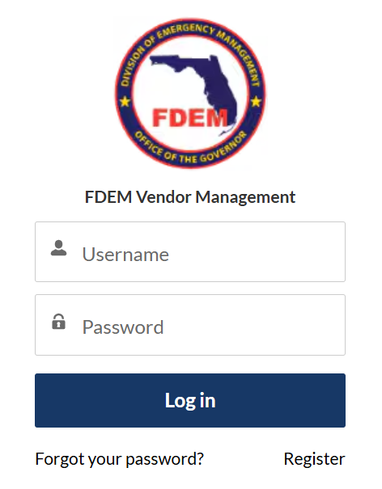
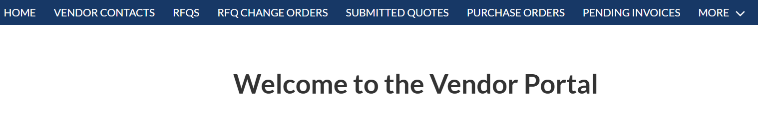
Login to the Vendor Portal
=https://www.fdemportal.com/vendors/s/login/?ec=302&startURL=%2Fvendors%2Fs%2F
1
Overview of how Vendors can log into the Vendor Portal to complete Procurement activities.
STEPS:
Navigate to the Vendor Portal in a web browser
Enter in your username (typically is an email address)
Enter in your uniquely created password
Click the Log in button
Ensure you are navigated to the Vendor Portal home page upon clicking Log in
Forgot Your Password?
Click on the Forgot your password? Hyperlink on the Log in screen
Enter in your username related to your account (typically is an email address)
Click Reset Password
Use the link sent your email to reset your password
2
3
4
5
Notes:
Step 1: Less URL link – Link

Slide 7
Submit a Quote

Slide 8



Key Activities: Submit a Quote
What’s happening?
Why?
Digital distribution of RFQs directly to vendor
portals
Vendors submit quotes directly in DEMES with a detailed and structured format
Reduces errors and inconsistencies in quote submissions, ensuring accuracy
Quicker turnaround times for quote submissions
and enhanced competitive bidding environment
Respond to RFQ
Create Quote
Submit Quote
Based off Mission requirements or other needs FDEM creates an RFQ and selects vendors who can respond
Vendors are notified of RFQ and review requirements of the RFQ, where they can decide if they will quote or pass on the RFQ
Procurement role will create a quote and enter in relevant details about what can be provided
Quote Line Items for Goods or Services must be added to the Quote for it to be submitted
When quote is ready for review by FDEM, the Procurement role will submit via the Submit Quote button
FDEM can not review quotes that aren’t submitted via the Vendor Portal

Slide 9
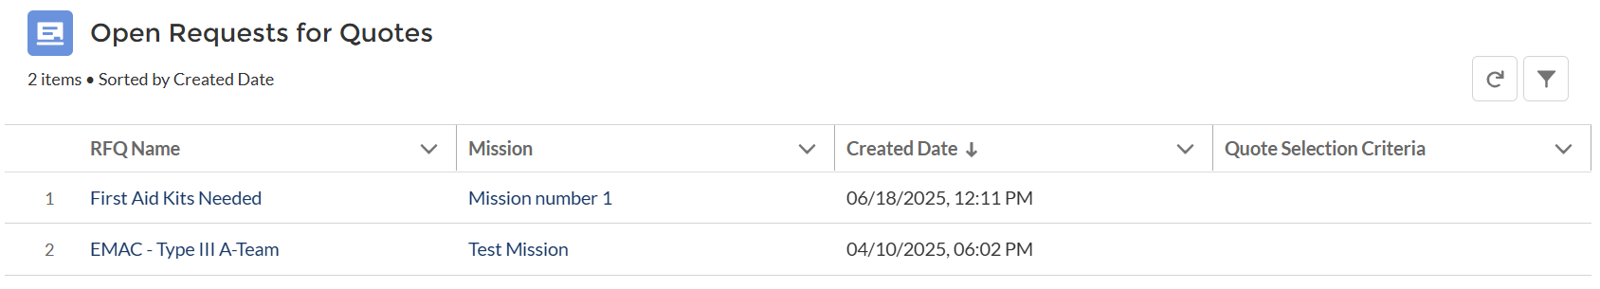
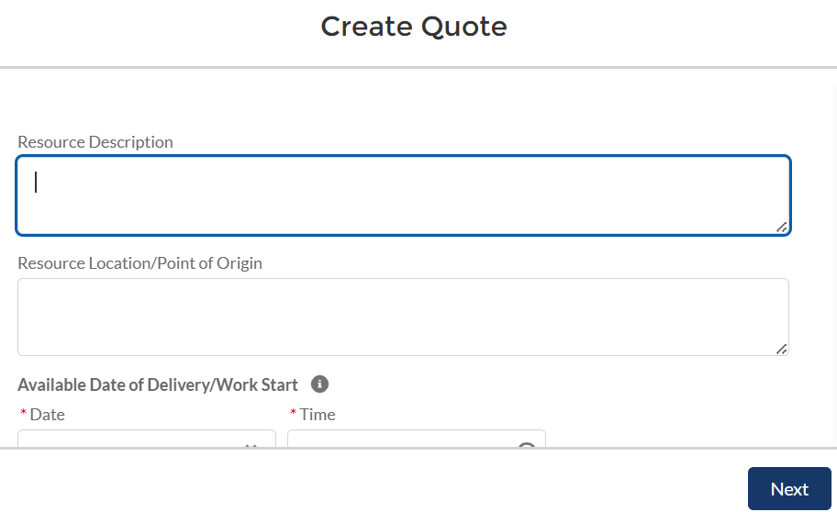
1
Creating and Submitting a Quote from an RFQ (1/2)
Overview of how to create and submit a quote in the Vendor portal
2
STEPS:
Log in to the Vendor Portal and click on the RFQs tab
Select the RFQ
Click the Create Quote button and fill in Quote details such as description, proposed start date, and any additional comments
Click Next once all details have been entered
3
3
4
4

Slide 10
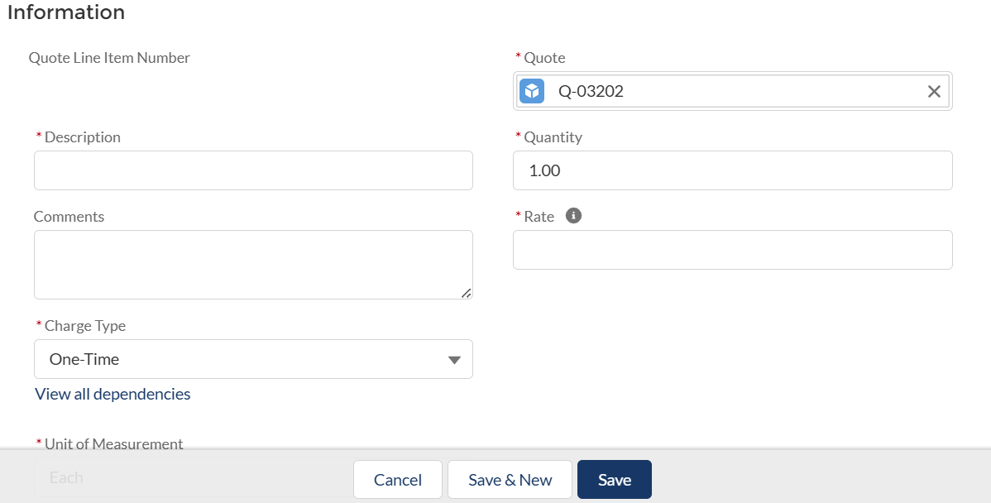
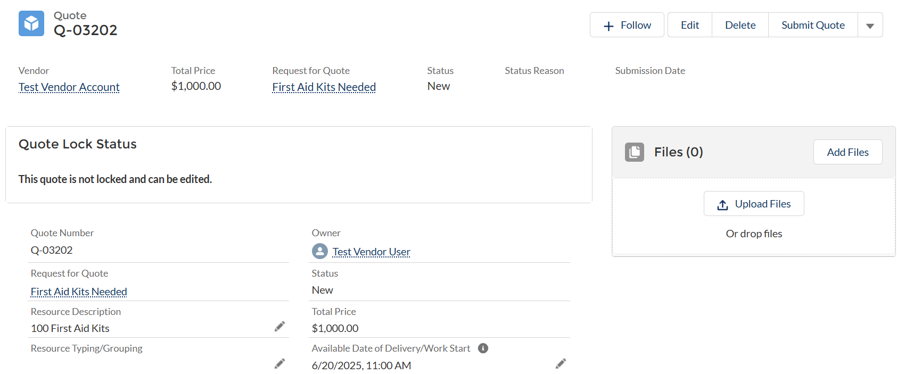
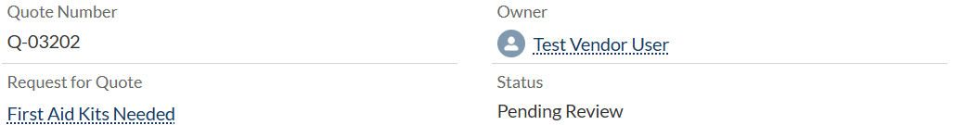
Creating and Submitting a Quote from an RFQ (2/2)
5
6
STEPS:
Scroll down to the Quote Line Items and click New
Add Quote Line Items specifying details for each, such as description, rate, and quantity
Review the completed quote to ensure all information is captured and comprehensive
Submit the quote for review by clicking the Submit Quote button
Ensure Quote status changes to Pending Review
Note: If quotes are not the Pending Review status, they will not be viewable for FDEM to review.
8
7
9
4

Slide 11

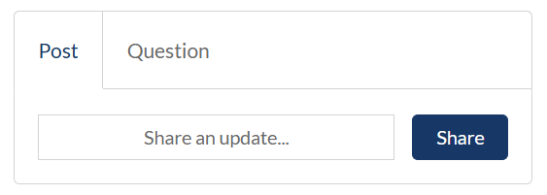
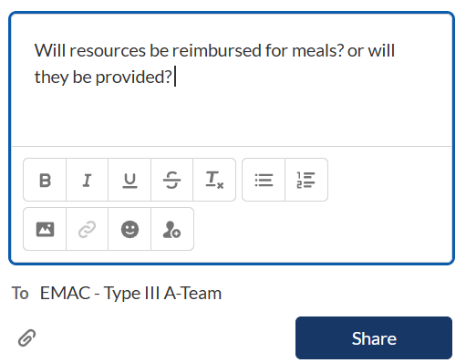
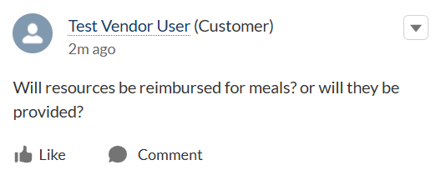
How to Submit Questions on RFQs
1
Overview of how to submit outstanding questions on RFQs for FDEM to see and respond to
2
STEPS:
Navigate to the RFQ you have an outstanding question on
Scroll until you see the Chatter component on the RFQ Page
Click into the Share an update text box and begin typing your question
Optionally, attach any related files or supported documentation related to the outstanding question
Click Share
Ensure that you can see the question posted on the RFQ
3
3
4
5
6
4

Slide 12
Submit an Invoice
Notes:
Calling out the submission steps in all areas – FDEM Cant submit for you
MFMP – Need to be registered so they be paid - W9 Form

Slide 13


Key Activities: Submit an Invoice
What’s happening?
Why?
Invoices are created and submitted through DEMES, with a defined process for review and approval
Electronic invoice submission and automated matching with POs
Expedited invoice processing leading to quicker payments to vendors
Reduction in payment cycles and improved cash
flow management
Review Purchase Order
Create Invoice
Submit Invoice
For Quotes that are Approved, FDEM will create a Purchase Order for the Vendors to submit their invoices on
The FPOC for the Vendor account will be notified of Purchase Orders status throughout the process
FPOC’s will create an invoice for the PO Line Items they need payment for and enter in all relevant details on the invoice; this should be similar to what is listed on the PO
Attachments such as receipts, advance payment approval, etc. will be required in order to submit
When all invoice details are reviewed and supporting documentation is present the Invoice can be submitted
FDEM can not review invoices if they have not been submitted via the Vendor Portal
Note: It is critical that if you are submitting an Invoice that you are registered with MFMP and have a valid W9 Form on file. This will ensure that payments aren’t delayed or received.
Notes:
Access Purchase Order, Fill out invoice details, Select invoice items from the PO like items
Submit the Invoice
Attachment of supporting documents

Slide 14
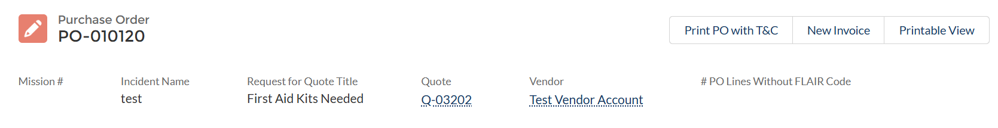
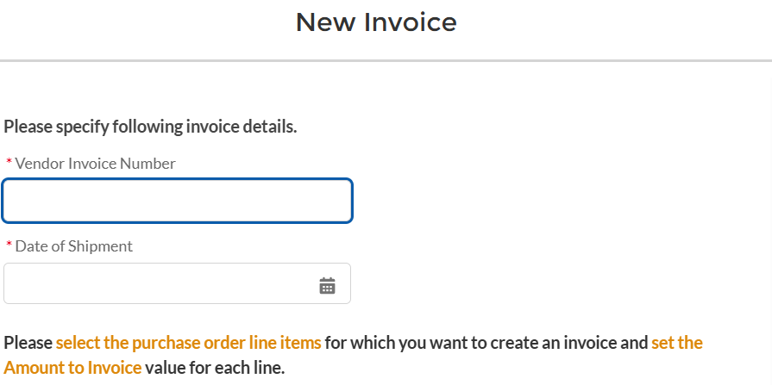
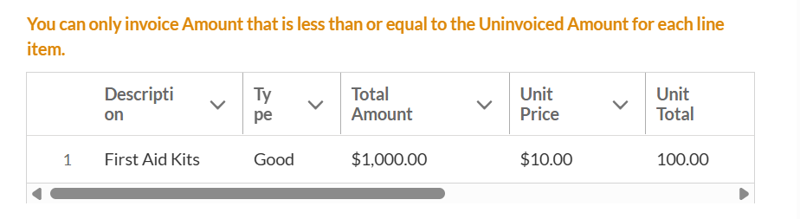
Creating and Submitting an Invoice (1/2)
1
Overview of how to create an Invoice in the Vendor Portal from a Purchase Order.
2
3
STEPS:
Navigate to the Purchase Orders tab in the Vendor Portal
Select the PO Record Name that has been fulfilled, or partially fulfilled
Click on the New Invoice button
Fill out invoice details by entering the invoice number and other relevant details.
Select invoice items from the PO line items to choose which items from the PO line items to invoice, including specifying quantities for partial invoices.
4
5

Slide 15
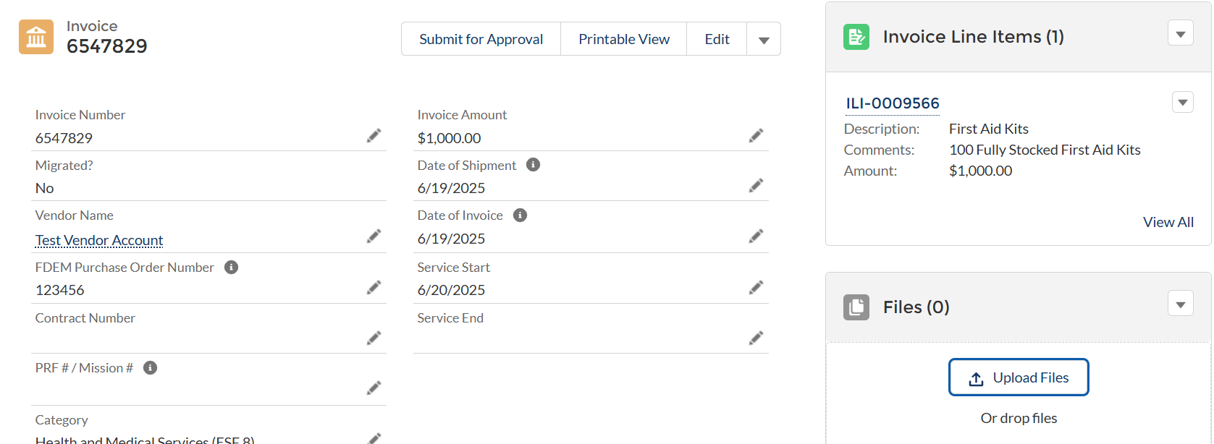
Creating and Submitting an Invoice (2/2)
STEPS:
Attach any supporting documentation to the invoice, such as receipts or other proofs of service.
Review the invoice details prior to click Submit for Approval
Note: If Invoices are not the Pending Validation status, they will not be viewable for FDEM to review.
6
7

Slide 16
Submit a Change Order

Slide 17


Key Activities: Submit a Change Order
What’s happening?
Why?
A systematized approach for requesting and processing change orders
Formal change orders are required for material
changes to the scope of the purchase order
Quick adaptation to project changes with minimal disruption
Provides a clear process for adapting to changes
in mission needs, ensuring proper tracking and accountability
Respond to Change Order
Create Change Order Quote
Implement Changes
Change Orders will be triggered by FDEM
Vendors will be notified of Change Orders and will be able to review and decide if they will or will not respond to the change order based on the details
Follows the same process as creating a quote but is done with the RFQ Change Order tab
Adjustments can be made Quote Line Items for Goods or Services and other relevant details on the quote prior to being submitted
Follow changes outlined in the change order to ensure that all quotes/purchase orders are fulfilled properly
Vendors can begin invoicing on Change Orders once the new Purchase Order is released by Finance

Slide 18
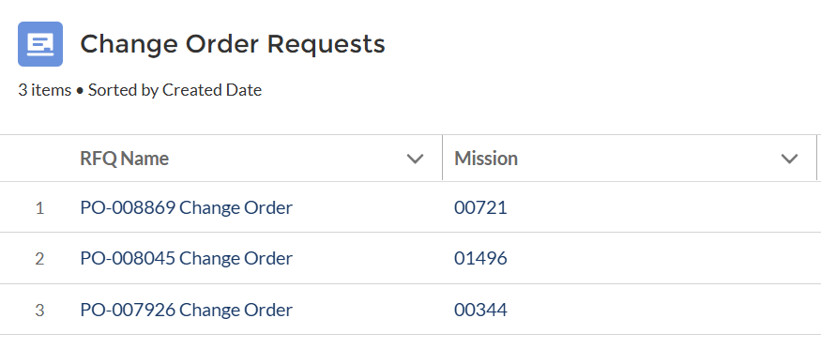
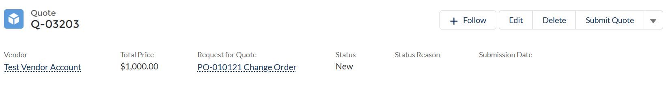
Creating and Submitting a Change Order
1
D
Overview of how to create and submit a change order within the vendor portal
STEPS:
Prerequisite: An email notification indicating that a change order request has been made for an existing purchase order (PO).
Access the DEMES portal using your vendor credentials and look for the 'RFQ Change Orders' tab.
Decision - Once there, you will see the change order request. Decide whether to proceed by creating a change order quote or to reject the RFQ based on your capacity and inventory.
If you decide to respond to the change order, click to create a new change order quote where you can adjust the details, as necessary.
Once you’ve made the necessary changes, review your new quote to make sure all details are correct, then submit it for FDEM’s review and approval.
2
3

Slide 19

Additional Support
For additional support, users are encouraged to complete the DEMES foundational eLearning courses, which provide essential knowledge on system navigation, application functionality, and mobile access to ensure confidence and efficiency in daily operations.
DEMES 104 | Introduction to DEMES
POINTS OF CONTACT
Contact your FDEM POC.

Slide 20
Thank You

Slide 21
Version Control
# | Changes | Name | Date
1.0 | New Course Creation | Slalom | 7.11.25

