Slide 1
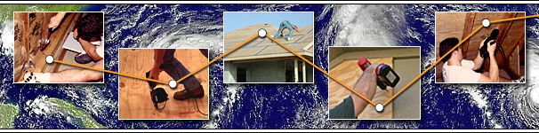


Make Mitigation Happen
A program of Florida’s Foundation and
the Florida Division of Emergency Management
Fun Funded by a grant from the Florida Division of Emergency Management, Residential Construction Mitigation Program
Residential Construction Mitigation Program

Slide 2
Introductions
Project funded by a grant from the Florida Division of Emergency Management
Today’s host
Today’s presenter
Notes:
Disclose project is a funded through the Florida Division of Emergency Management
Recognize host
Introduce presenter
Introduce disaster recovery organizations or VIPs

Slide 3
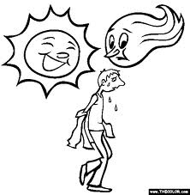
Notes:
We are here today not to discuss typical Florida weather but....

Slide 4
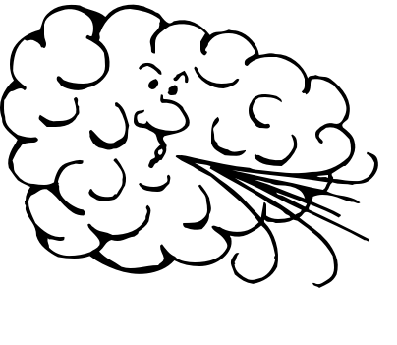
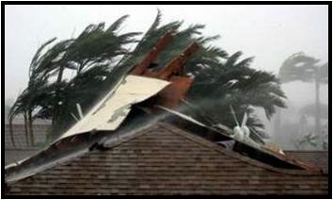
What is Mitigation
Notes:
…to discuss how hurricane force winds can damage your home and what you can do to protect it.
Shutters can be seen, so they are the first things most people think of when protecting their home against high winds. But shuttering windows is only one of the recommended activities. It’s what you can’t see that can make a big difference.
Mitigation is defined as a noun that is the lessening of the force or intensity of something unpleasant.
The primary damages from hurricanes are wind and water intrusion. The first step is to have an inspection of your home.

Slide 5
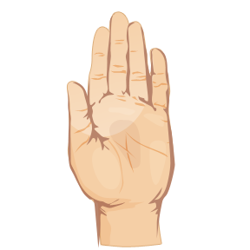
Survey
Who plans to mitigate?
What do you want to learn today?
Notes:
If there is a small group, you may have participants introduce themselves.
Take quick count and take notes. At the end of the training, ask question again and see if there is an increase. Record this observation as part of the training evaluation.
Ensure all issues brought up in “what do you want to learn” are addressed in the training. Take note so trends of commonly asked questions/identified issues can be noted.

Slide 6
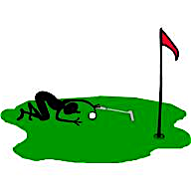
Purpose
Research-based activities
Benefits
Do-it-yourself or not?
Other resources available
Notes:
Most activities address single family homes. Other construction is more difficult to ensure security. Example...multi-unit dwellings will require all units mitigate to the same standard for uniform protection. Mobile homes require additional anchoring and are generally not constructed to withstand the winds of a major hurricane.
Newly constructed single family homes should already incorporate many of these activities to meet state-wide standard building code. Similarly new Mobile home construction has incorporated some advances but activities after placement, such as properly installed tie downs, could be an issue. It may also be useful to state that Mobile homes must be physically relocated periodically to meet federal code. Structures such as porches or decks cannot be part of the Mobile home if it is to move every 6 or so months.
All activities presented today are research-based proven measures to help secure your home against damage caused by hurricanes.
The benefits of mitigation are added security, faster recovery and lower costs for homeowners insurance and lower costs to recover from a disaster.
We will give you enough information today to determine what activities you can do yourself and what activities are recommended for the services of a contractor.
We will also discuss the resources available to help you mitigate your home, certify your home is properly mitigated and prepare for other disasters.

Slide 7

Definitions
Continuous load
Soffits
Gables
Glazed surfaces
Notes:
Continuous load - imagine picking up your house and turning it upside down. You want everything to stay attached. Roof-to-wall, wall-to-foundation. A continuous load path improves the ability of your house to withstand high-wind forces as a single unit, not a connection of joints.
Soffits - the overhang of your house - the area between the external wall and the roof.
Gables - the portion of wall between sloping roof. Generally triangular in nature.
Glazed surfaces - windows, doors with glass inserts, sliding glass doors, glass block, etc.

Slide 8
Resource Recognition
IBHS - Insurance Institute for Business and Home Safety
FDEM - Florida Division of Emergency Management
Florida’s Disaster Fund
FIND - Florida Interfaith Networking in Disaster
FLASH - Federal Alliance for Safe Homes
Blueprint for Safety
FEMA - Federal Emergency Management Agency
Florida Building Commission & Florida Building Codes
Notes:
The following organizations contributed to the content of this presentation.
Reinforce the consistent message among all groups contributing to this training.

Slide 9

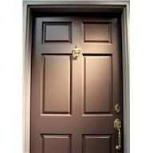
Wind Pressure
Notes:
Wind pressure keeps planes aloft.
Story to relate wind pressure:
It’s a crisp spring afternoon. I open the back doors and windows of my home to enjoy the cool dry air. Although there is a gentle breeze outside, the newspaper on the kitchen table doesn’t flutter.
A pair of Girl Scouts knocks on the front door. I rush to the front (because I love those cookies and last year I missed out because I wasn’t home.) Within an instant of cracking the door open, a loud bang vibrates from the back to the front of the house. The back door had slammed shut with more force than seemed possible and fifty sheets of newspaper flew all over the kitchen. What happened?
The most common answer is that wind blew the door shut. In a sense, I guess it did but it wasn’t air moving through the house that pushed the door closed. After all, it would take several seconds for wind to travel through the home and push the back door closed. It was actually air pressure or more precisely, the difference in air pressures. As wind blows around the outside of any obstruction, it creates a positive pressure on the side it is blowing, the front door in this example. What is less intuitive is that it creates a negative pressure or suction on the downwind side. When I opened the door, the positive pressure on the front of the house combined with the negative pressure on the back of the house and slammed the door shut with much more force than would be anticipated from a gentle spring breeze.
Wind force exponentially increases with wind speed. In other words, doubling the wind speed will quadruple the wind forces. When you consider what that fifteen mile per hour breeze did to my back door, you can really appreciate the forces involved in a 130 mile per hour hurricane.

Slide 10
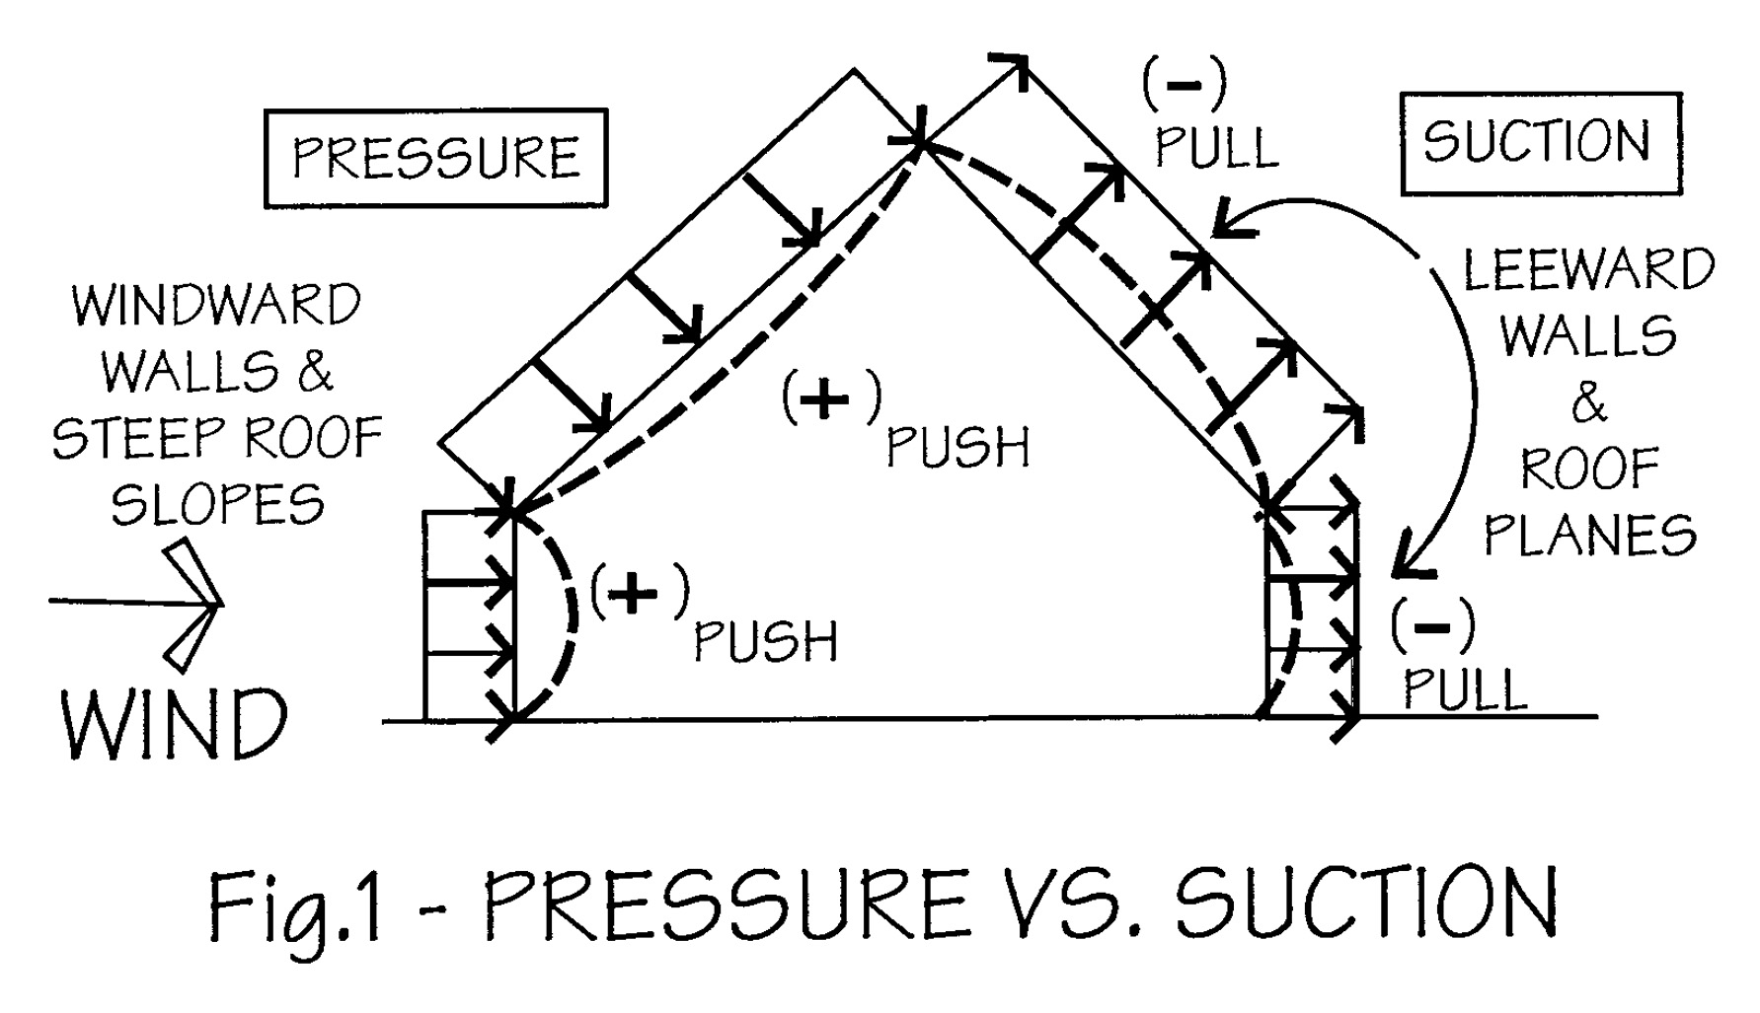
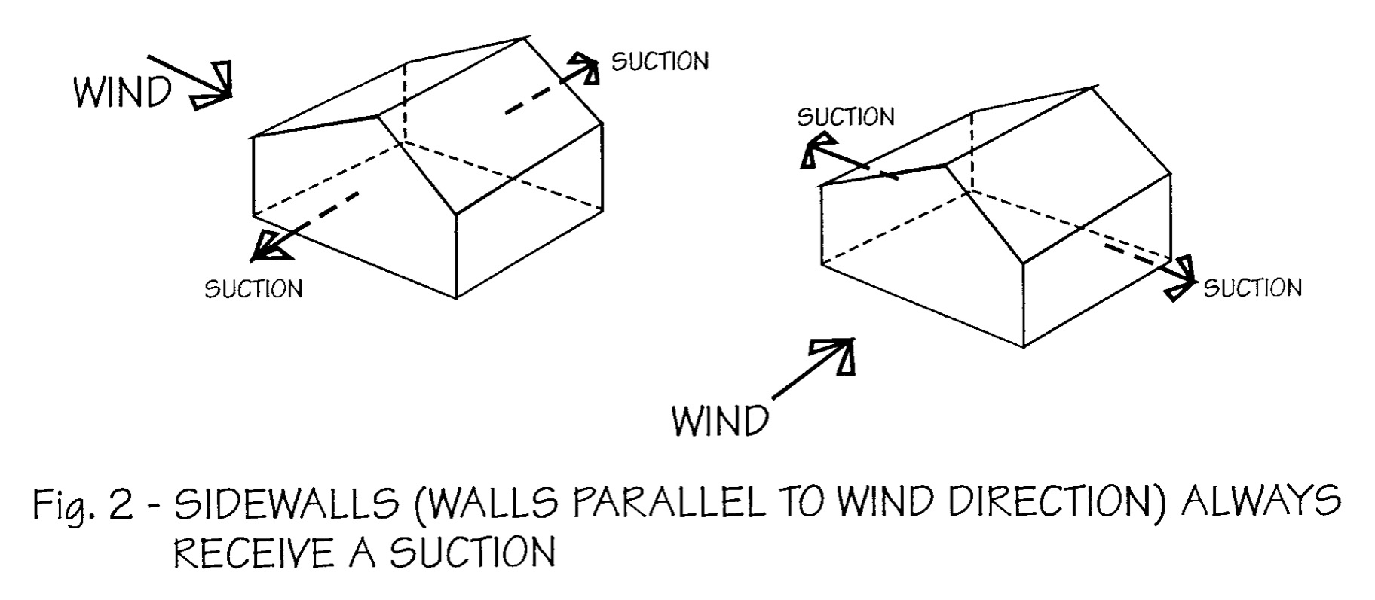
Wind Pressure vs. Suction
Images courtesy of Blueprint for Safety. For more information go to www.blueprintforsafety.org.
Notes:
Note – Images from Blueprint for Safety – a product of a collaboration of private and public interests working under the direction of the Federal Alliance for Safe Homes (FLASH).
Hurricane force winds create varying pressures and effects on your home. This changes throughout the occurrence of a storm and is not a constant effect. This changing pressure can cause bowing and weakening of walls.
Suction is also know as pull and lift.

Slide 11
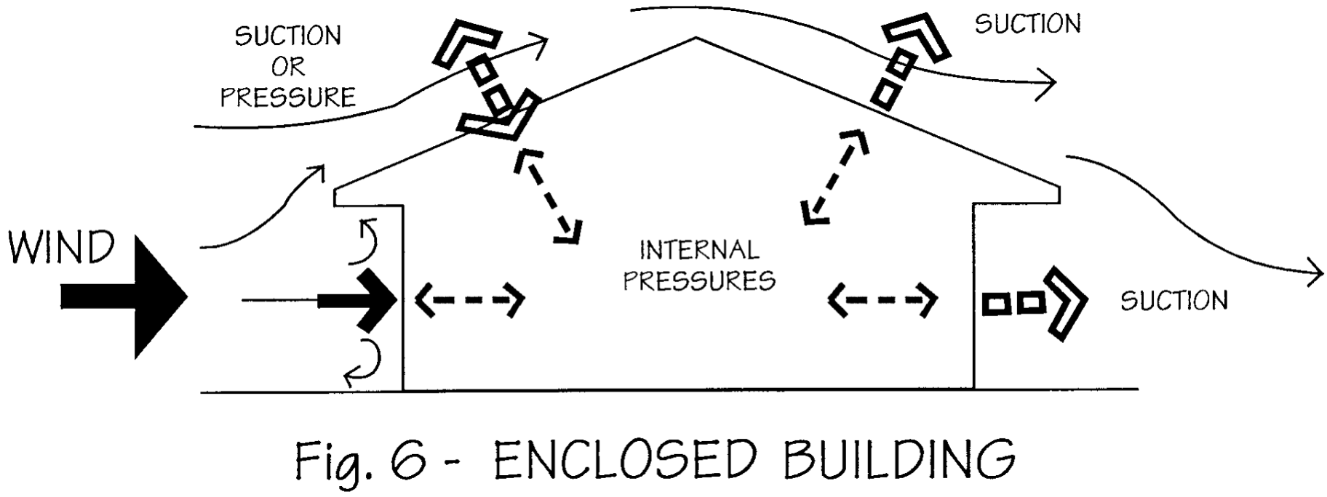
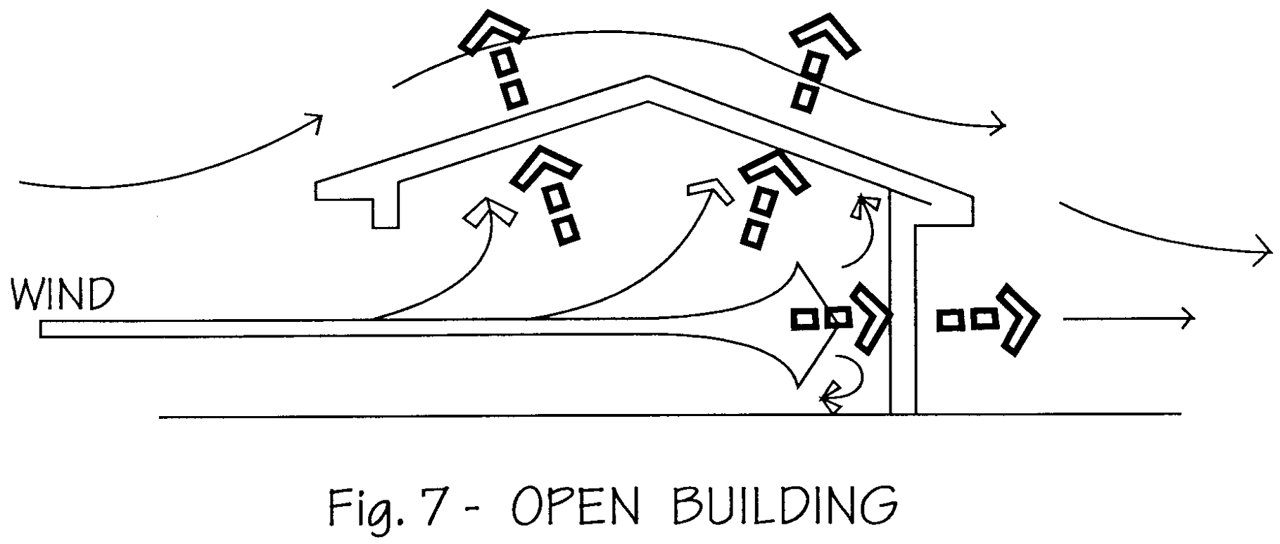
Wind Pressure vs. Suction
Images courtesy of Blueprint for Safety. For more information go to www.blueprintforsafety.org.
Notes:
Once wind has access into a home, through windows or doors, especially a doorway as wide as french doors or garage doors, the pressure shifts to lifting the roof deck off the house. So ideally we want to keep wind from accessing the home.
The city of Homestead virtually exploded due to this effect during Hurricane Andrew. Once the wind penetrated the home it swelled like a balloon as the roof popped off and then the walls collapsed leaving only the slab. Mobile homes were reduced to twisted scrap metal wrapped around the remaining trees and telephone poles.
Newly constructed single family homes should already incorporate most of these activities to meet state wide standard building code. Similarly new Mobile home construction has incorporated some advances but activities after placement, such as properly installed tie downs, could be an issue.

Slide 12

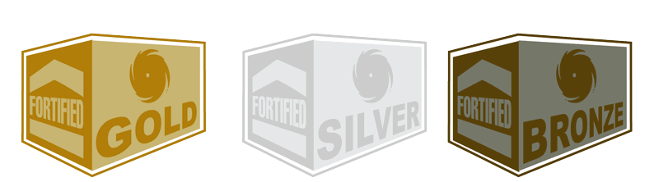
Institute for Business and Home Safety (IBHS)
Mission: “To conduct objective, scientific research to identify and promote effective actions that strengthen homes, businesses, and communities against natural disasters and other causes of loss.”
Fortified for Existing Homes - voluntary program certifying superior construction standards
Notes:
Before we watch a demonstration video, I want to introduce you to the Institute for Business and Home Safety.
They achieve their mission through conducting research on the science of building, identifying mitigation solutions, improving public policy and developing voluntary standards and guidance.
They are one of many resources we used to develop this guide for you.
They have the only program at this time that provides a certified rating of your home. The program requires you to follow recommended steps to mitigate your home and you receive either a bronze, silver or gold rating based on the strength of your home.
Historically the approach to mitigation has been an “all-or-none” approach. IBHS’s research recognizes that some mitigation is better than none.

Slide 13
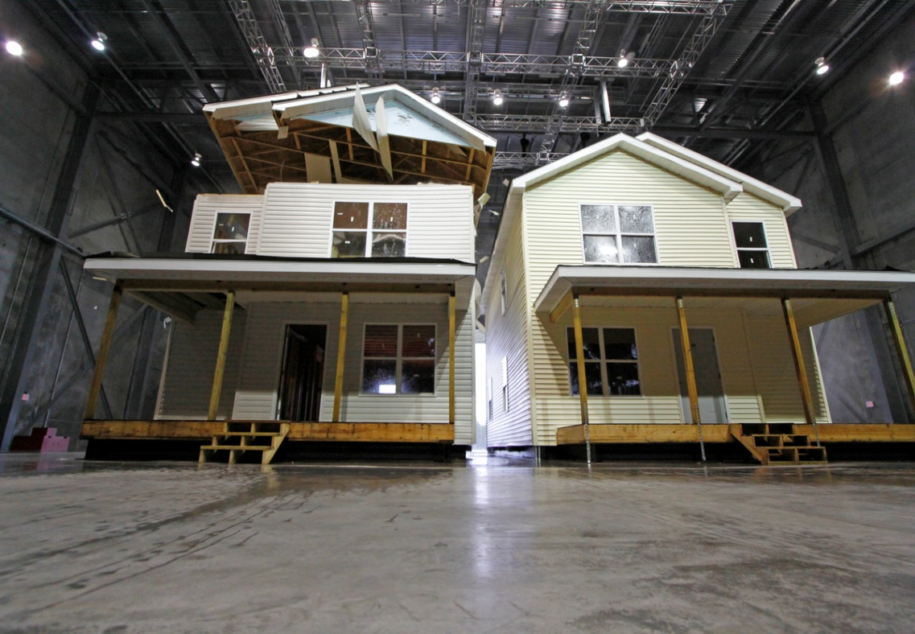

Cost vs. Benefit
Notes:
The video we are about to watch is a demonstration video of research conducted by IBHS. They compare homes built to code vs. homes built above code and in accordance with IBHS Gold Fortified Standards. Florida is moving to increase building codes to comply with higher wind mitigation standards, but at this time, recommended mitigation activities are above building code standards.
Cost of upgrades for new construction: $3000
Research found a repair cost ratio 5:1

Slide 14
Video
Notes:
IBHS has approved the use of their research video -
One important item to note is that it is the same fortified home in all the videos. The home withstood the wind test again and again.

Slide 15
Wind Pressure vs. Suction
Images courtesy of Blueprint for Safety. For more information go to www.blueprintforsafety.org.
Notes:
Now lets look again at the pressure vs. suction and review the impact of the homes on the video.
We saw the push and pull on the roof deck.
We saw wind blow open the door and the walls sucked out, and the pull on the roof deck.

Slide 16
Wind Pressure vs. Suction
Images courtesy of Blueprint for Safety. For more information go to www.blueprintforsafety.org.
Notes:
Repeat:
Once wind has access into a home, through windows or doors, especially a doorway as wide as french doors or garage doors, the pressure shifts to lifting the roof deck off the house. So ideally we want to keep wind from accessing the home.
This action was clear in the video.

Slide 17
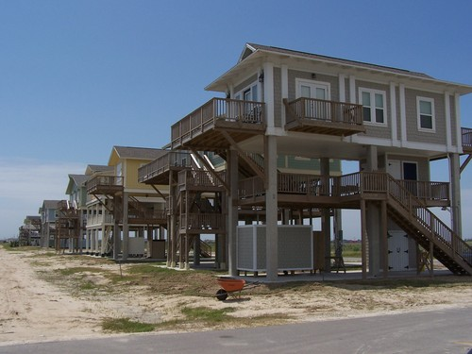
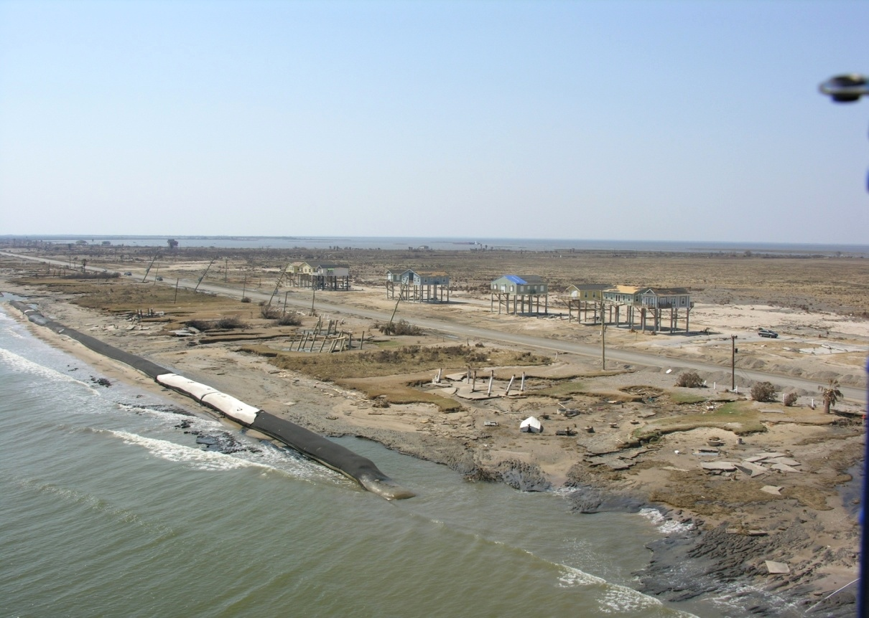
Research Based Activities
Notes:
Research into structural failure of homes became focused after Hurricane Andrew. Damage seen during Hurricane Andrew prompted building code changes and additional research. The homes you see in the photo were mitigated using the activities we will review today and they survived Hurricane Ike (Texas Coast).
The one mitigated home - the one with the blue tarp - was significantly damaged from surrounding debris striking the house.

Slide 18
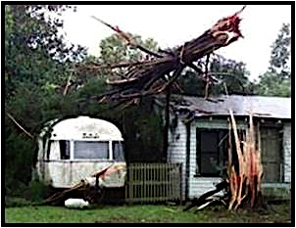
Evacuation Orders
Notes:
No amount of strengthening of your home should ever cause you to disregard evacuation orders.
The arm bands of hurricanes can spawn tornados and the high winds can hurl objects at such high speeds that no amount of mitigation can withstand.

Slide 19
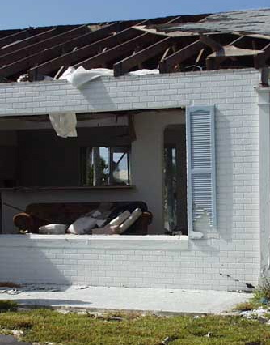
Why Mitigate?
Your home is your largest asset
Reduce insurance premiums
Reduce damage
Reduce debris
Reduce recovery time
Estimated benefit is $4 saved for every $1 spent
Notes:
Security, Economic & Recovery
Recovery factors
You can see from this photo, the roof deck lifted directly where a large window was broken.
In the event of a storm, you evacuate to a secure shelter. Now lets look at two scenarios. Scenario A - you don’t mitigate, Scenario B - you mitigate your home.
Scenario A - A large piece of the roof to your home is missing, there is significant water damage to three rooms of your house and four windows are shattered. Clearly this is not a safe environment and mold will grow within days.
Scenario B - There is minimal damage to your roof due to a tree leaning on your home. There is minor water damage in your living room and is manageable by placing a tarp on your roof. You are back in your home after one night in a shelter.

Slide 20
Why Mitigate?
627.711 F.S. - Insurance premium savings
Increase the value of your home
Increase ability to resale your home
When a disaster hits
Notes:
WHEN a disaster occurs. These savings are dependent on many different variables (debris, tornados) and cannot be predicted.

Slide 21
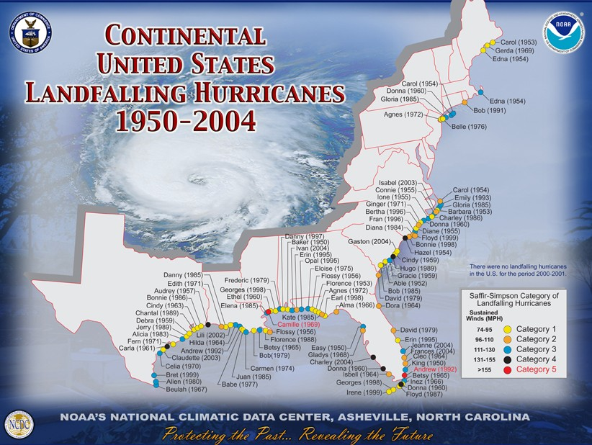
Notes:
Look at hurricanes to impact FL from 1950 - 2004. Participants will have recent memory of hurricanes. Discuss recent hurricanes - Katrina, Wilma, etc. Reinforces “WHEN” a disaster happens.

Slide 22
Insurance Savings
Savings on your homeowners insurance premium.
This discount is applied to the hurricane portion of the homeowners premium.
The average hurricane premium with Auto Club Insurance Company of Florida is $610. The average insurance savings through mitigation is approx. $300 annually.
So…how do the discounts apply?
Notes:
In addition to providing additional protection to your home, wind mitigation also offers savings on your homeowners insurance premium. This discount is applied to the hurricane portion of the homeowners premium (declaration page handout with personal information blocked out).
Although premium rates vary from company to company, the average hurricane premium with Auto Club Insurance Company of Florida is $610. (As you can imagine, hurricane premium rates are higher in coastal markets than in the interior of the state.) The average insurance savings through mitigation is approximately $300.
So…how do the discounts apply? Lets take a look at the inspection form which identifies the mitigation features and estimated discounts. (Handout Office Of Insurance Regulation hurricane loss mitigation form).

Slide 23
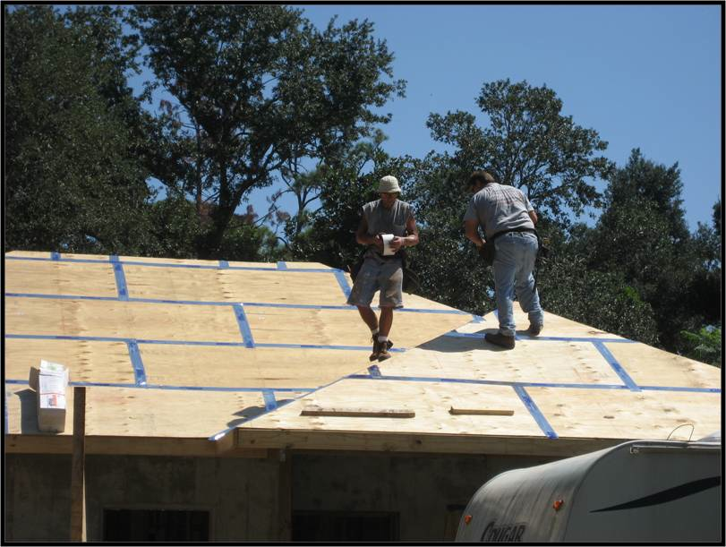
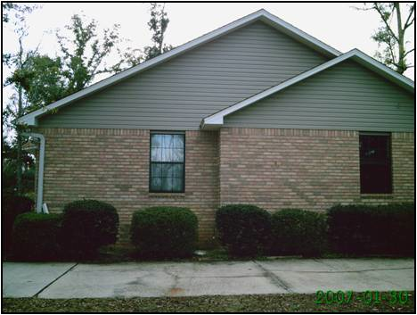
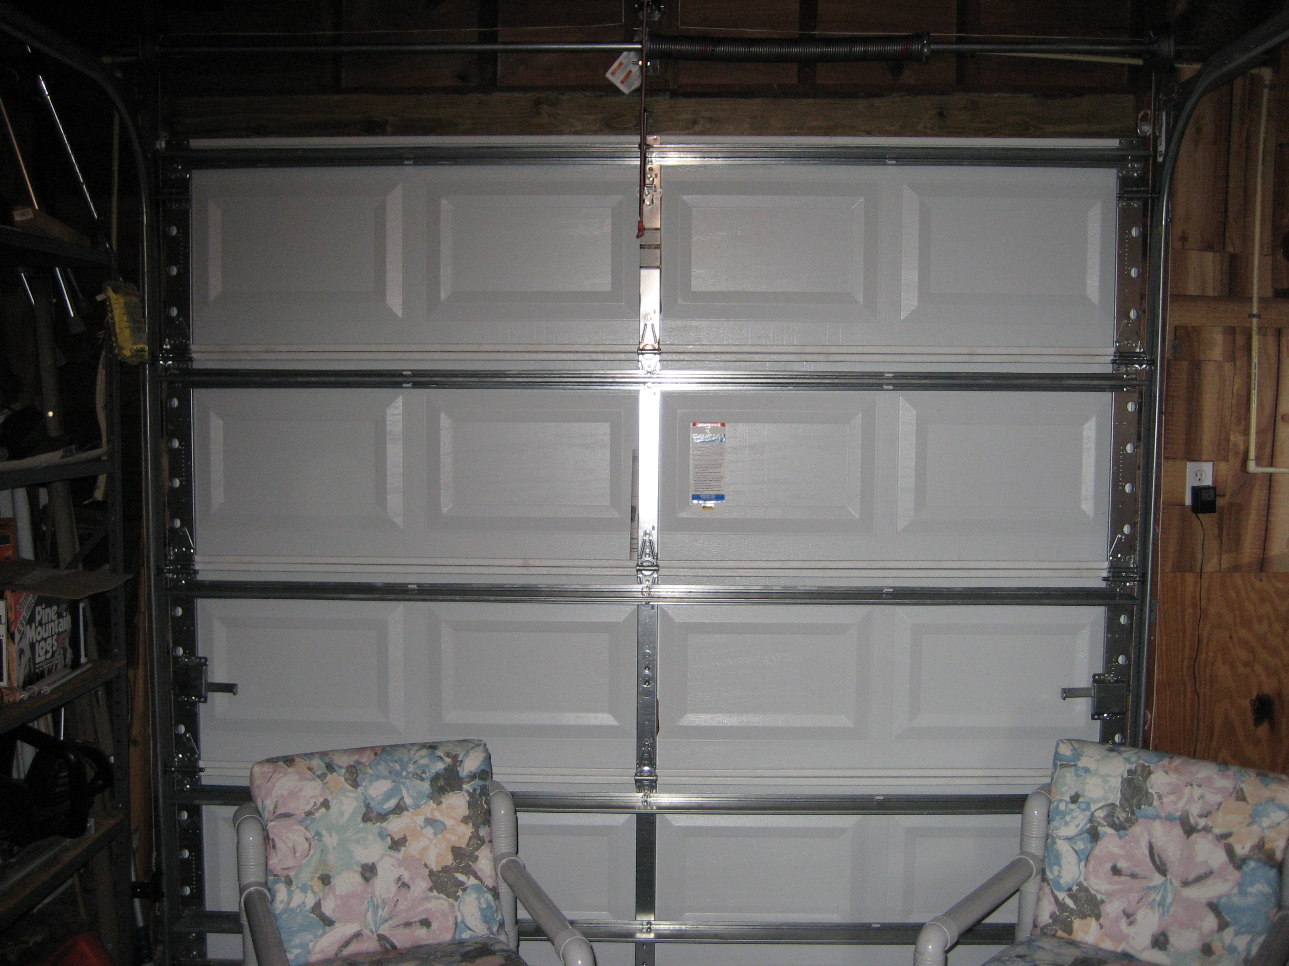
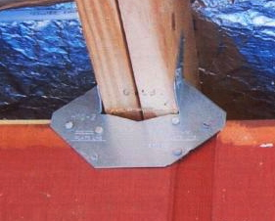
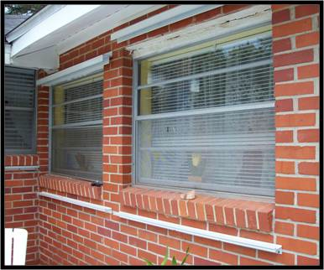
Types of Mitigation
Water Barriers
Gable Ends
Garage Doors
Anchoring
Glazed Openings
Notes:
Setting water barriers, anchoring, and bracing gable ends generally requires a significant labor commitment. Window openings and doorways generally require customized materials and a wide variety of products exist to assist persons with disabilities.

Slide 24
Local Permits
Permitting varies by region, county and municipality. Always check with your local building department to ensure all work is properly permitted.
Permitting ensures compliance with current building code.
Permitting ensures accurate and effective mitigation.
If permitting is required, insurance discounts will not be provided without proof of permitting and final inspection.
Notes:
Ensures products are installed to manufacturer specifications.
This presentation is consistent with 2007 building code. 2010 building code, when it becomes effective will change specifications for many items, particularly water barriers and roofing. The building code is the minimum requirements for construction. Many mitigation items recommended are above code.
Caution ONLY do-it-yourself within your skill set.
Note “beware of drive by inspections” where county or city inspectors barely get out of their car to look at the work.

Slide 25

Water Barriers
How does water enter a home during a storm?
Why do you want to make sure your home is dry and if necessary dry out your home after a storm?
Notes:
This presentation is consistent with 2007 building code. 2010 building code, when it becomes effective will change specifications for many items, particularly water barriers and roofing. The building code is the minimum requirements for construction. Many mitigation items recommended are above code.
Water enters a home through
- poorly sealed windows, doors,
- attic vents, gable vents, soffit vents,
- wall penetrations for utilities, and
- cracks in walls and frames.
The pressure alone from 100-mph winds can move water up a crack or vent 3 1/2 inches.
Loss of roof coverings can create areas where significant amount of water intrudes.
Mold and mildew can grow within 24 hours. Mildew is a specific type of mold. Mold spores - air born - travel through the air and attach to moist surfaces. As long as it is over 68 degrees and damp, mold will grow.
Wind driven water can penetrate vents and pool above ceiling wall board eventually causing it to collapse.
Let’s start with the top of the house and work our way down.

Slide 26
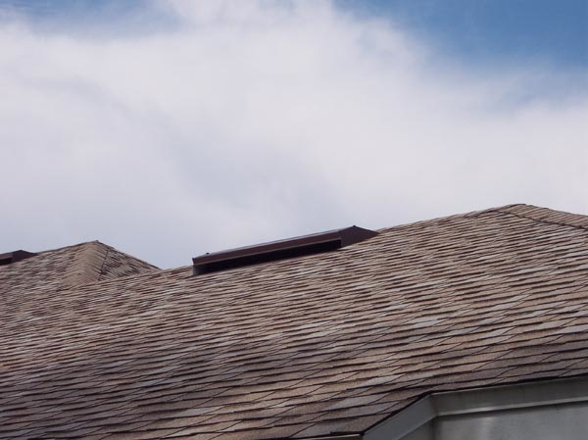
Water Barriers
Underlayment
Types of roof coverings
Notes:
When re-roofing your home make sure the roof deck is solid and have any rotten, cracked or deteriorated boards replaced.
On the roof deck you can tape the horizontal and vertical seams with a 4” or wider self-adhering membrane tape followed by a synthetic underlayment. Self-adhering tape may have difficulty adhering to the surface due to the texture, any wax added and general job-site conditions. A primer may be needed to secure attachment of the tape.
For the underlayment, the Institute for Business and Home Safety recommends a code compliant 30-pound ASTM D226, Type II underlayment and attached using annular ring or deformed shank roof fasteners with minimum 1-inch diameter caps. Metal caps are recommended where wind speeds may exceed 140 mpg.
Roof coverings come with varying grades based on wind ratings. Whether installing asphalt shingles, clay tiles or concrete tiles, make sure you follow manufacturers recommendations for installation in high-wind prone zones.
The average recommended replacement age for a tar shingle roof is approximately 12 – 15 years which applies to both new and existing construction.

Slide 27
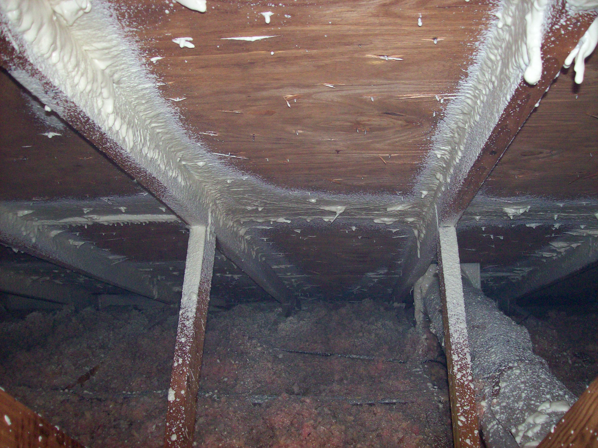
Water Barriers
Polyurethane foam
Notes:
If not re-roofing your home you can still do the following:
Check to see that the nails attaching your roof deck enter the rafter beams.
Within the attic you may use spray-on polyurethane foam that is an adhesive providing additional anchoring of the roof deck and is an acceptable water barrier. This is messy!
Documentation of application from a properly trained and qualified applicator is generally required for insurance discounts.

Slide 28
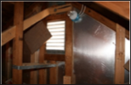
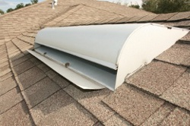
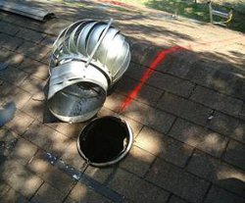
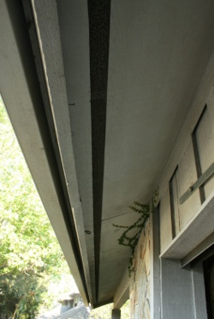
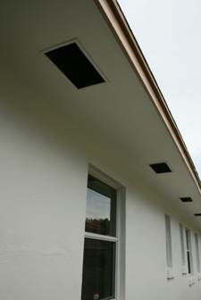
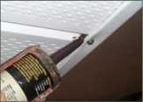
Water Barriers
Gable vents
Soffit vents
Roof Vents
Notes:
Vents also require covering, or require installation of vents that prevent water intrusion. It may also be necessary to reinforce the installation of soffits. While it can be difficult to cover vents only during a storm, major damage can be cause by leaving temporary vent covers in place permanently or over long periods of time. Most attics are designed to be ventilated and require the air flow.
The pictures above show a gable end vent cover from within an attic that is set on a hinge so it may be easily covered in the event of a storm. The picture -lower middle- shows the added precaution of caulking the connection gaps of aluminum soffits. Aluminum soffits are not permitted in some high-wind zone areas of Florida, based on local building codes.

Slide 29
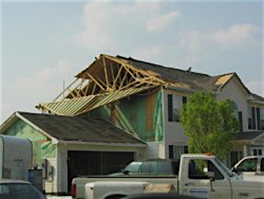
Gable Ends
Notes:
This presentation is consistent with 2007 building code. 2010 building code, when it becomes effective will change specifications for many items, particularly water barriers and roofing. The building code is the minimum requirements for construction. Many mitigation items recommended are above code.
Gable ends respond to pressure within the house by bowing in and out. This action looses the connections to the wall and roof. When reinforcing the roof-to-wall connections at the gable ends, also make sure you reinforce the connections at the base of the gable end to the wall below.

Slide 30
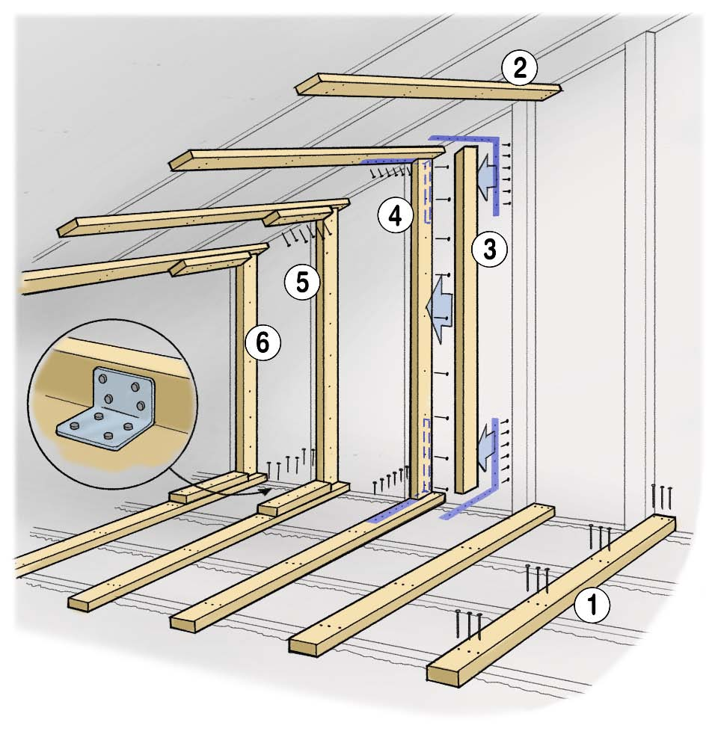
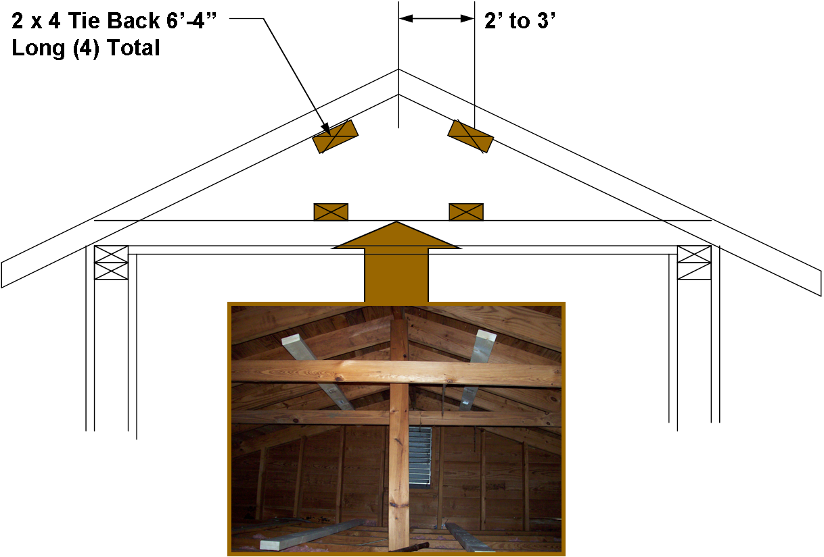
Gable Ends
Notes:
Mitigating gable ends includes two primary activities. The most common way is to place four horizontal beams two to three feet from the point of the gable end. Horizontal beams should be at least six feet and long enough to connect to at least three attic floor framing boards and extend 2 1/2 feet past the third board. If there is a gap in connecting the horizontal beam to the gable wall, which is more common in block homes, use a wood shim to close the gap.
The reinforcement of horizontal beams against the gable minimizes the bowing that occurs as pressure within the house varies during a storm.
In the picture above, the added horizontal frames are painted white so the mitigation is clear. When installing the horizontal beams, it may be best to install the lower beams first to extend the walking surface in the attic. Make sure you do not pinch wires between the boards as this may result in a fire hazard.
Picture on Right - In some cases, an engineer may recommend multiple vertical beams attached to an existing stud and connecting to the horizontal beam. This creates a U-shape against the gable end wall. Connect the beam with an L-shape strap and reinforce with a block of wood at the joint to further compress the connection. The top of the retrofit stud should be cut square and does not have to match the pitch of the roof. Further secure the retrofit stud by applying construction adhesive along the sheathing (wall of the gable end).
It is also important to ensure the base of the gable is connected to the roof and wall below. Reinforce these connections in order to anchor the gable.

Slide 31
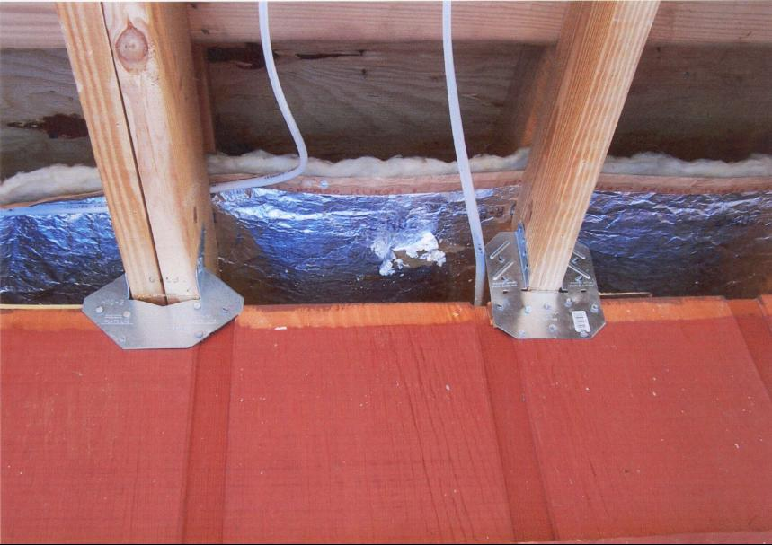
Anchoring: Roof to Wall
Notes:
This presentation is consistent with 2007 building code. 2010 building code, when it becomes effective will change specifications for many items, particularly water barriers and roofing. The building code is the minimum requirements for construction. Many mitigation items recommended are above code.
A roof tie-down - should do when re-roofing.
On existing homes this generally encompasses the removal of the soffit to expose where the rafters meet the wall framing. Most homes have a standard connection on one side of the beams. For high-wind resistance metal connectors are bolted to both sides where the rafter and the wall frame meet. A double wrap connector is a continuous connector in the shape of a modified U to fit the framing.
Every connection, every joint must be secured.

Slide 32
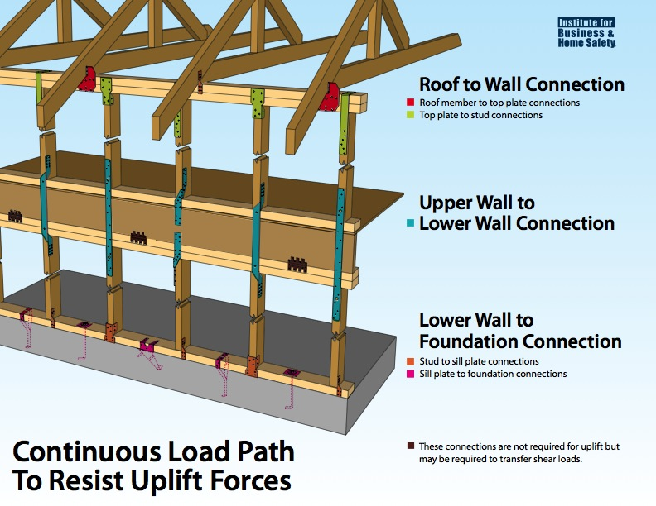
Notes:
With the anchoring you are establishing a continuous load path.

Slide 33
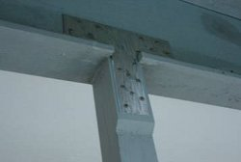
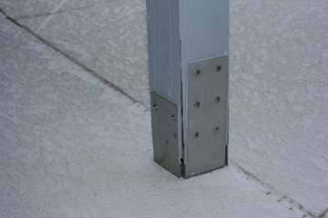
Anchoring: Porches and Overhangs
Notes:
This presentation is consistent with 2007 building code. 2010 building code, when it becomes effective will change specifications for many items, particularly water barriers and roofing. The building code is the minimum requirements for construction. Many mitigation items recommended are above code.
Reinforce wood porch frames much as you would the roof-to-wall and wall-to-foundation for the home. A variety of connectors and strappings are made to support frames at the base and roof joints.
The center picture above shows damage to a home once the front porch frame was removed by high winds and the front window damaged.
Aluminum porches and screen frames (often found around pool decks) are not designed to withstand hurricane force winds. As most aluminum porches are attached to the boards at the eaves of homes the best mitigation is to ensure the board is well-reinforced to the roof structure to ensure the board continues connection to the home if the aluminum frame is damaged.
Myth vs. Fact - cutting away screens helps - no research conducted to show benefit. Most damage done to porches is when aluminum framing bends or is hit by debris.

Slide 34

Q: When do you need to secure adjacent structures?
Q: Does it help to cut away the screen?
Notes:
Q: When do you need to secure adjacent structures?
When it shares the same roof
When it is connected to the home
Q: Does it help to cut away the screen?
No research conducted on whether this has benefit. Most damage done to porches is when aluminum framing bends or is hit by debris.

Slide 35

Questions
Mitigation from roof to walls
Notes:
Note all questions allowing for an FAQ listing / improved presentation.

Slide 36
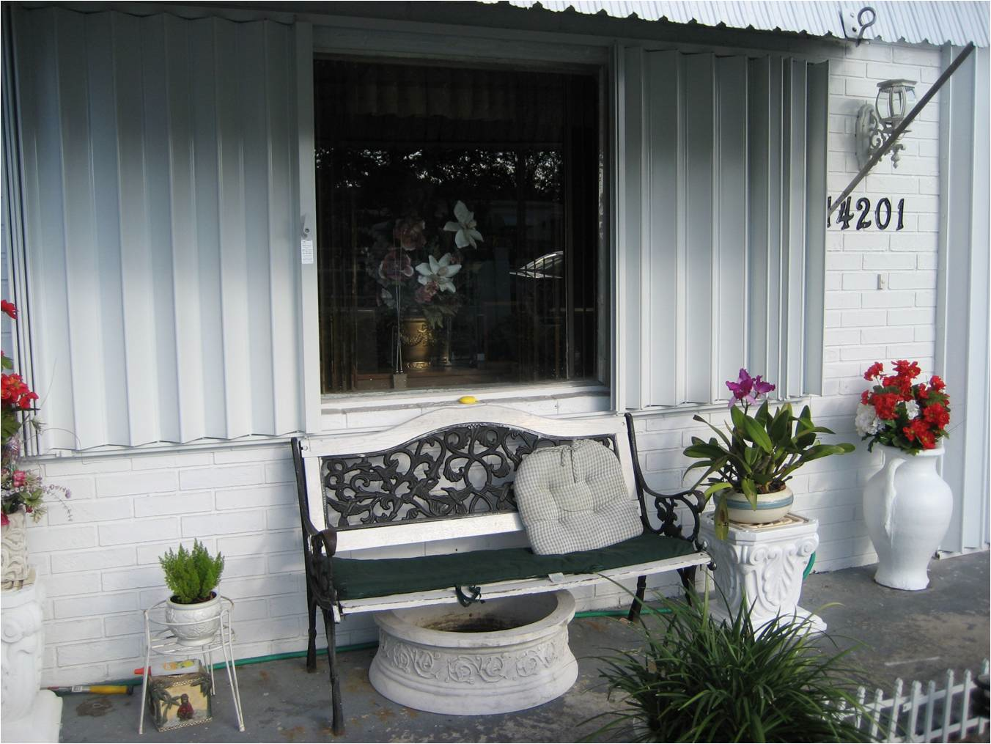
Glazed Surfaces
Step 1: Inspect
Step 2: Shutter or replace
Notes:
This presentation is consistent with 2007 building code. 2010 building code, when it becomes effective will change specifications for many items, particularly water barriers and roofing. The building code is the minimum requirements for construction. Many mitigation items recommended are above code.
Inspect - all window frames and sills to ensure framing is solid, free of rot, water damage and gaps. Replace damaged framing boards.
Shutter - we’ll review types of shutters
Replacement - when to replace windows and doors

Slide 37
Q: What helps protect your glazed surfaces?
Fabric shutters
Impact resistant glass
Plywood boards
Steel panels
Accordion shutters
Masking tape

Slide 38
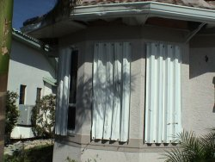
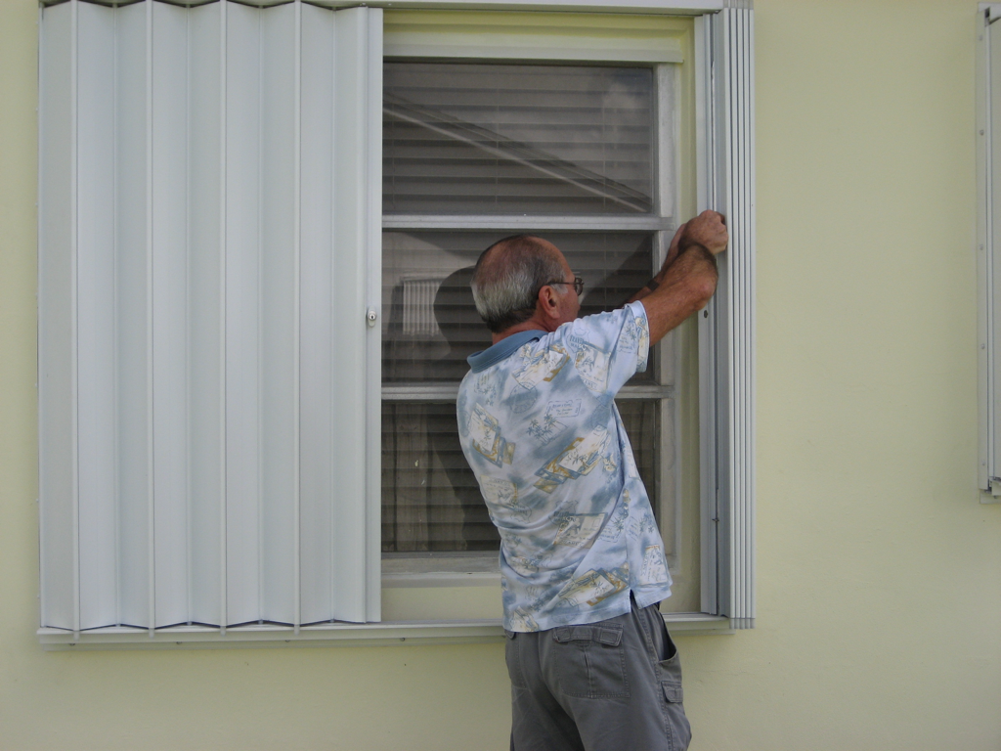
Glazed Surfaces
Replace windows with impact resistant glass
Shutters
Notes:
Impact resistant glass - doesn’t mean they cannot break and can be expensive to replace
Panels come in steel, light-weight aluminum, plexi-glass and cloth. For those with sight impairment, a clear reinforced plexi-glass shutter may be preferred to allow in natural light. For the elderly, mounted shutters may be preferred to eliminate the need for storage and lifting. For those with limited movement, automatic/electric roll down shutters may be preferred. Light-weight panels or cloth may be preferred in lieu of heavier steel or plywood boards.

Slide 39
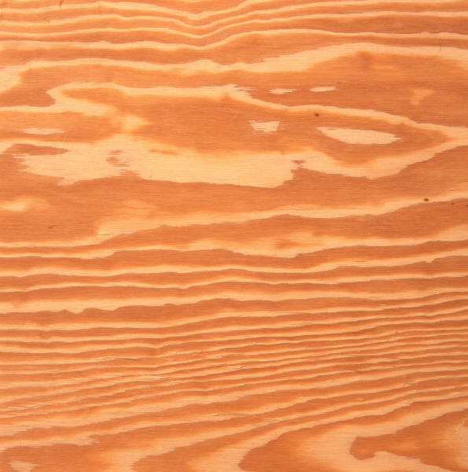
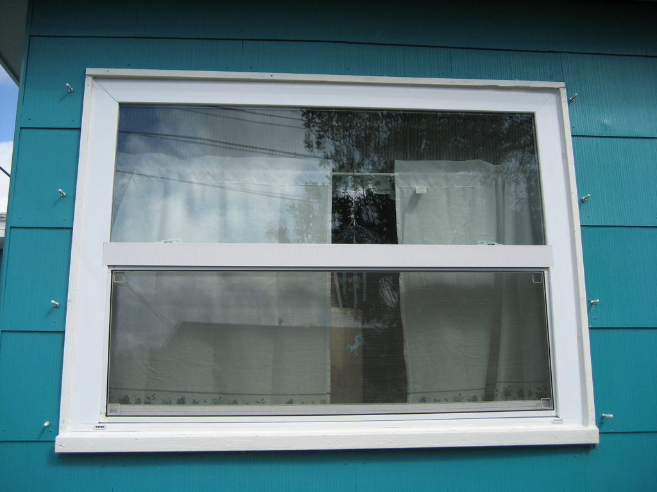

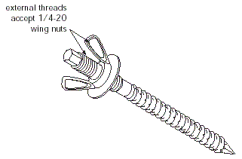
Glazed Surfaces: Panel Shutters
Notes:
Shutters can be permanently mounted to the home like roll-down shutters or accordion style shutters OR installed only during a storm.
Panel shutters are installed only during a storm. Plywood can be easily cut to fit any window and with a variety of clips, plywood can be easy to mount and install. Plywood makes adequate panel shutters, but generally will not qualify for insurance premium discounts.
Panel shutters installed only during a storm are usually installed on a track or post support system. Posts are wing nut bolts mounted into the framing. - You can hardly see them!

Slide 40
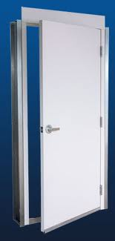
Main Entries
Secure reinforced door frame
Doors are solid and open out
3 or 4 door hinges
1” dead bolt
Proper installation is critical
Notes:
Recommendation - have two exit points to your home. Remember sliding glass doors and doors with decorative glass should be shuttered. In most cases, you should replace your existing door with a wind rated door. Wind rated doors are solid doors with no glass or with impact resistant glass inserts. Doors should be mounted with four hinges that are secured with screws long enough to anchor into the door frame and surrounding wall stud. You should utilize 1” deadbolts and make sure the door frame is secure. Caulk and add weather stripping where needed.
For all purposes, including insurance discounts, the installation of the door must be in compliance with Florida Building Code and hurricane rated.
Often in older homes screws are not installed into the frames as required. Also, sometimes the hinges are not secured with the appropriate number of screws per hinge. This should be a simple item to have fixed by any carpenter or locksmith.

Slide 41
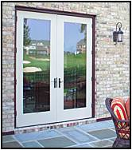
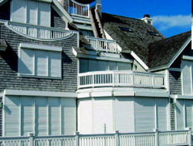
French Doors and Large Openings
Notes:
SHUTTER! The center beam of double doors cannot withstand hurricane force winds. Shutter as one unit, don’t shutter as two separate doorways.

Slide 42
Garage Doors
Notes:
This presentation is consistent with 2007 building code. 2010 building code, when it becomes effective will change specifications for many items, particularly water barriers and roofing. The building code is the minimum requirements for construction. Many mitigation items recommended are above code.
Wind rated garage doors are generally solid doors with extra bracing. The added weight of a solid door requires reinforced tracks and a stronger garage door opener.
Often during a hurricane, power is lost for a period of time. In the event of a major storm, power may be out for days. Make sure the garage door opener has a manual release. Also, given the added weight of a wind rated garage door, the garage door should not be your primary exit. It may be difficult to open the door after a storm.
Garage doors should be shuttered, replaced with a wind rated door or in some cases can be reinforced by adding a bracing bar behind each panel. In order to ensure stability and wind resistance, most commonly the recommendation is to replace and properly install a wind-rated garage door.

Slide 43
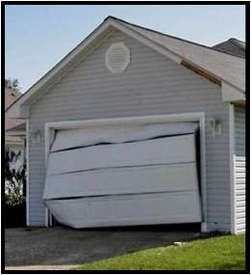
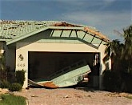
Q: Does your car make a good brace?
Notes:
Garage doors can be pulled out or pushed in with the wind pressure. Using your car to brace your garage door will only result in your car being damaged with impact from the garage door.
The owner on the right had significant damage to their car too.

Slide 44
Questions
Mitigation of glazed surfaces and doors
Notes:
Note all questions allowing for an FAQ listing / improved presentation.

Slide 45
Contract vs. Do-It-Yourself
For most activities a contractor is recommended. If you choose to mitigate your home or complete some activities yourself, these resources may help you....
  FDEM Hurricane Retrofit Guide www.floridadisaster.org/hrg/index.asp
  FEMA Wind Mitigation for Existing Homes Guide www.ready.gov/hurricanes
  IBHS Engineering Guide www.disastersafety.org/content/data/file/IBHS_FOR-engineering-guide.pdf
  FLASH How-to Video Guides www.flash.org/video.php
  Florida Building Commission www.floridabuilding.org/c/
  Blueprint for Safety www.blueprintforsafety.org/animated-how-to.php
Notes:
This presentation is consistent with 2007 building code. 2010 building code, when it becomes effective will change specifications for many items, particularly water barriers and roofing. The building code is the minimum requirements for construction. Many mitigation items recommended are above code.

Slide 46

Tale of Two Homes Video
Notes:
Video to be imbedded or use hyperlink to show Tale of Two Homes Part 1. Time 4:23

Slide 47
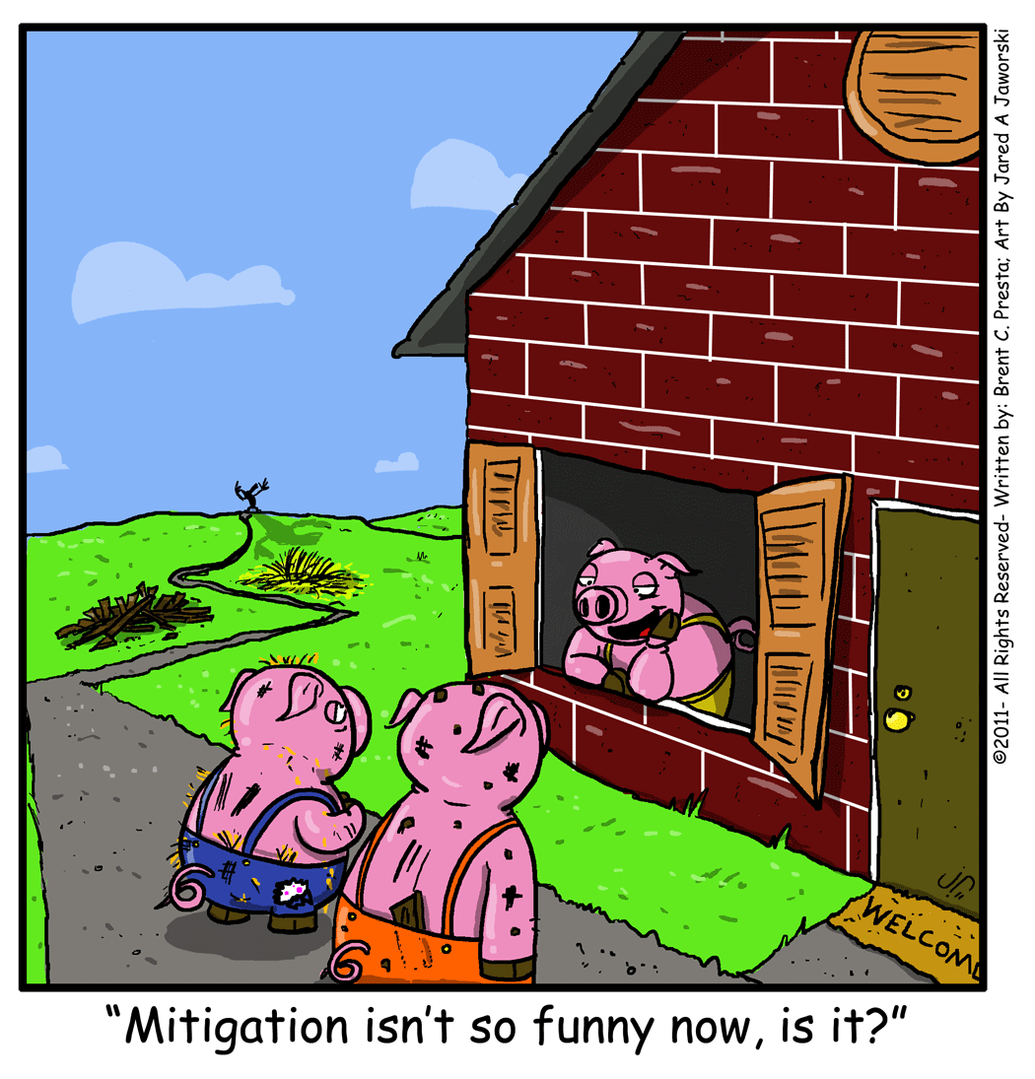

Slide 48
Why Mitigate
Notes:
No amount of strengthening of your home should ever cause you to disregard evacuation orders.
Allow audience to answer question.
Priorities for mitigation:
- keep water and out - roof deck/covering, windows, doors
- keep roof on - continuous load

Slide 49
Survey
Who plans to mitigate?
Notes:
Ask question again and see if there is an increase. Record this observation as part of the training evaluation.

Slide 50
Tips
❍ Get A Plan! www.FloridaDisaster.org
❍ Have current information www.FloridaEvacuates.com
❍ Let others know your plan
❍ If you want to help volunteer, sign up prior to a disaster warning
❍ Wind: Anchor lawn items
❍ Wind: Remove gravel and replace with mulch
❍ Fire: Areas kept free of clutter and debris
❍ Fire: Trim hedges and tree limbs away from house
❍ Fire: Plant only low-flammability plants near home
❍ Flood: Elevate air conditioning unit and other major appliances
❍ Flood: Clear all drains
❍ Flood: Installed back-flow valves on primary drains
❍ ALL Disasters: Evacuate when required

Slide 51


